Slide 1
SUBVERSION
SVN (Subversion) is a version control system that helps developers manage changes to their code and files over time. It allows teams to collaborate, track revisions, and revert to previous versions if needed.
Key Features of SVN:
Centralized Version Control – Unlike Git (which is distributed), SVN follows a centralized model with a single repository.
Revision Tracking – Keeps track of all changes, allowing users to roll back to previous versions.
Branching & Merging – Supports creating branches for development and later merging them back.
Access Control – Allows setting permissions for different users.
Efficient Storage – Uses delta encoding to store only changes, saving space.

Slide 2
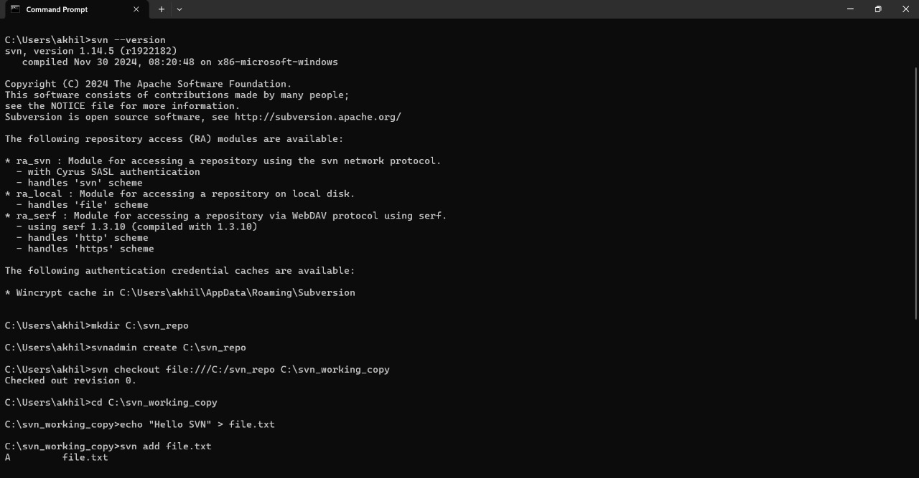
COMMANDS

Slide 3
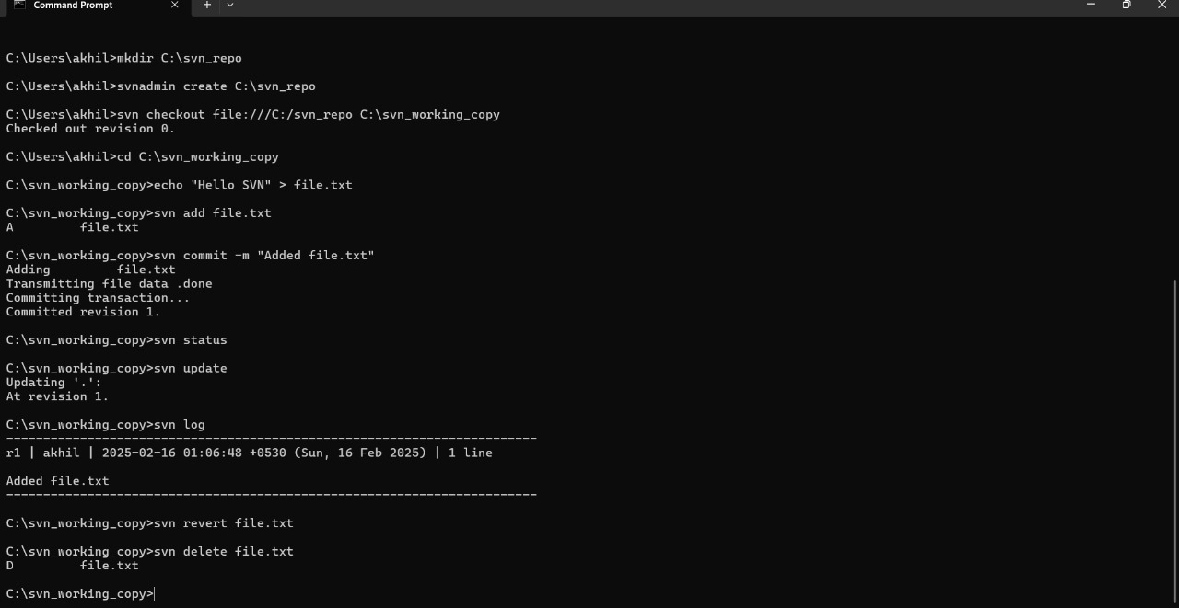

Slide 4
MERCURIAL
Mercurial (HG) is a distributed version control system (DVCS) like Git, designed for speed, simplicity, and scalability. It helps developers track changes in code, collaborate on projects, and maintain a history of modifications.
Key Features of Mercurial:
Distributed Model – Every user has a full copy of the repository, enabling offline work.
Fast & Scalable – Optimized for large projects with many commits.
Simple Command Set – Fewer commands compared to Git, making it easier to learn.
Atomic Commits – Ensures complete or no commit, preventing partial updates.
Branching & Merging – Supports lightweight branching with easy merging.
Cross-Platform Support – Works on Windows, Linux, and macOS.

Slide 5
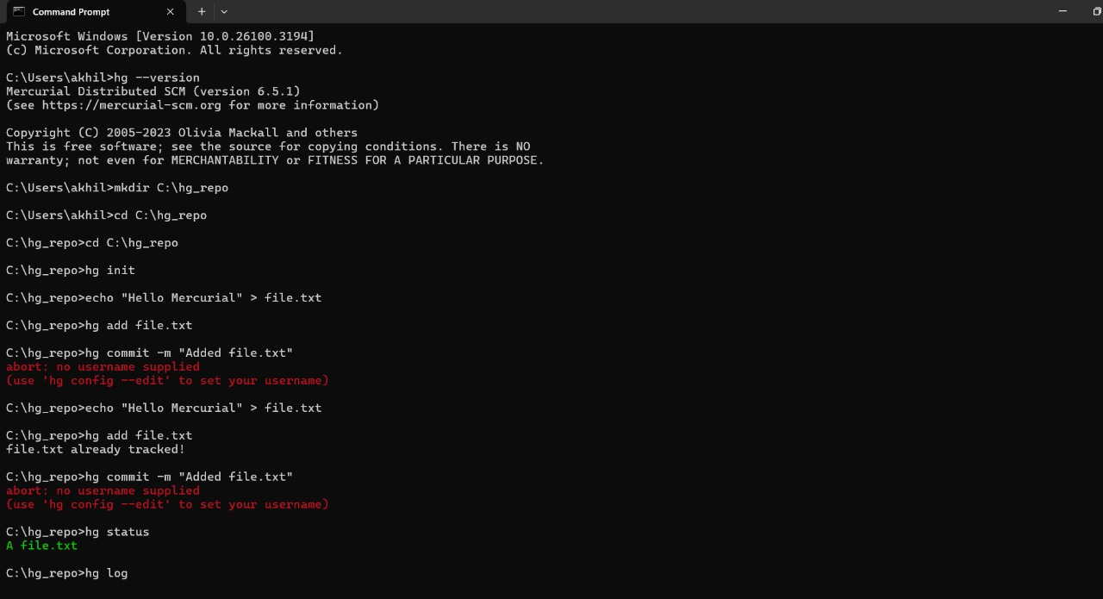
COMMANDS

Slide 6
